Slide 2
Bias / Variance (обобщающая способность)

Slide 3
Основные понятия
Признак (feature)
Объект (object)
Чистые данные (tidy data)
Набор данных (dataset)
Модель
Шкала

Slide 4
Определение чистых данных (tidy data)
Каждая переменная соответствует колонке
Каждое измерение соответствует строке
Каждая таблица\файл содержит данные об одном виде наблюдений\экспериментов

Slide 5
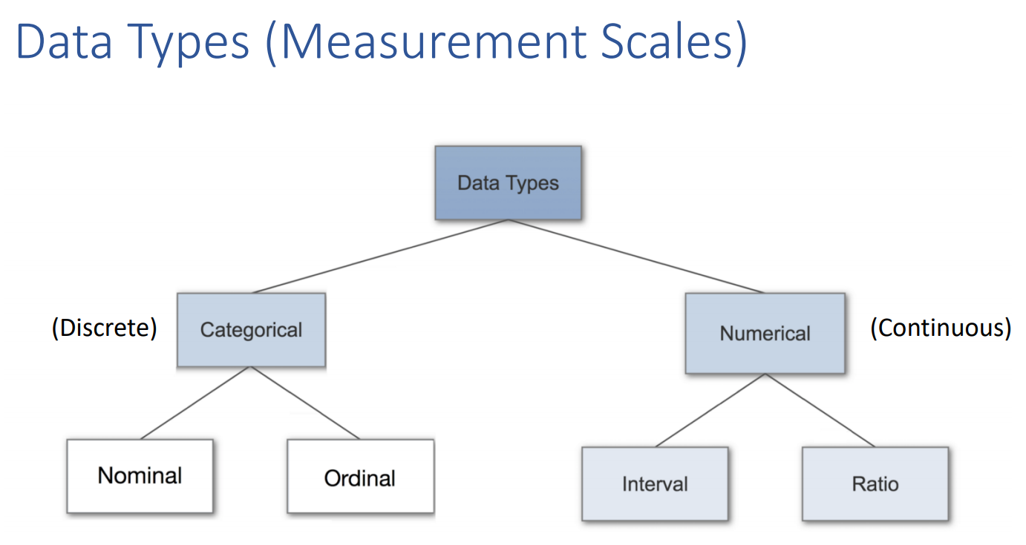

Slide 6
Обзор данных (data exploration)
Отсутствующие данные
Значения вне разумного диапазона
Ошибки в единицах измерения (шкалах)
Ошибки в подписях переменных (колонок)
Ошибки в классах переменных

Slide 7
Предварительная обработка данных
Создание новых переменных
Слияние наборов данных
Трансформация переменных
Удаление несогласованных данных

Slide 8
Bias / Variance
Прежде чем обучать модель (подстраивать ее параметры), нужно выбрать вид модели

Slide 9

Bias / Variance
Прежде чем обучать модель (подстраивать ее параметры), нужно выбрать вид модели

Slide 10
Bias / Variance and generalization ability
Прежде чем обучать модель (подстраивать ее параметры), нужно выбрать вид модели

Slide 11
Bias / Variance and generalization ability
Прежде чем обучать модель (подстраивать ее параметры), нужно выбрать вид модели
У сложных моделей много параметров, у простых - мало

Slide 12
Bias / Variance and generalization ability
Хорошая модель описывает не столько данный датасет, сколько все остальное.

Slide 13
Оценка эффективности модели

Slide 14
Оценка эффективности модели
Никогда не оценивайте эффективность модели на том же наборе данных, на котором она училась!
Главное достоинство моделей машинного обучения - описывать точки, которые не присутствуют в обучающей выборке - обобщающая способность.
Как оценить эффективность модели на данных, которых у нас нет?

Slide 15
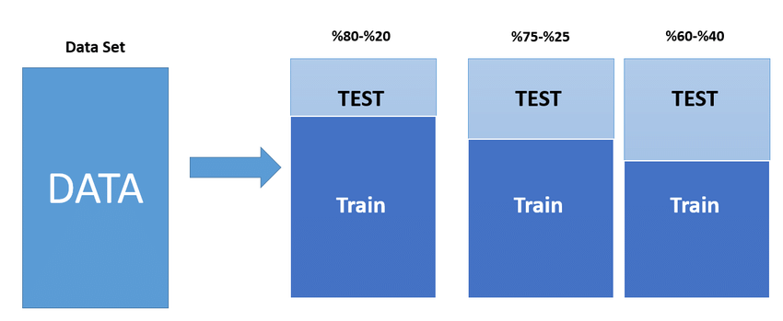
Holdout sets and effectiveness reporting

Slide 16
Переобучение и недообучение

Slide 17
Переобучение и недообучение
Модель подстраивает свои параметры, анализирую точки обучающей выборки.
Чем точек (данных) больше, тем полнее обучение.
Можно построить зависимость точности модели от объема обучающей выборки.

Slide 18
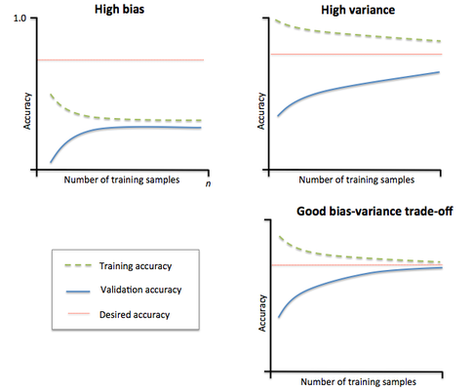
Underfitting and overfitting
Такой график называется кривой обучения

Slide 19
Underfitting and overfitting

Slide 20
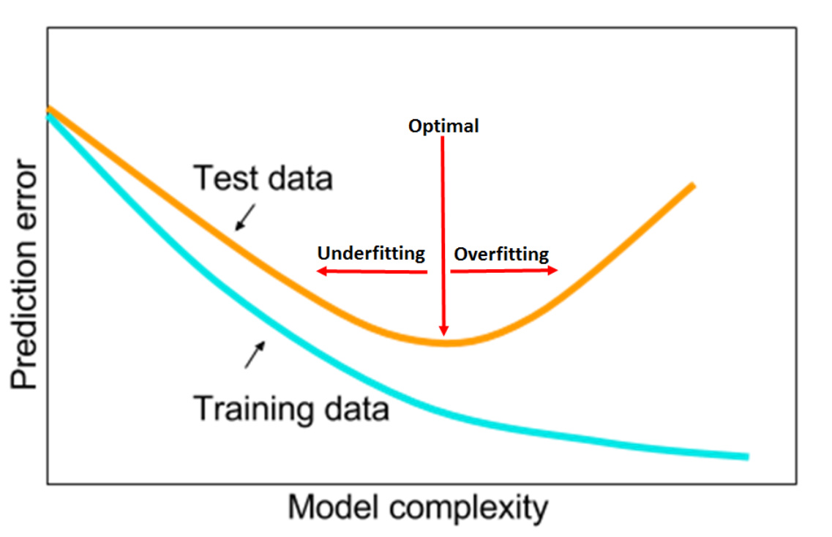
Underfitting and overfitting

Slide 21
Model selection and cross-validation
В машинном обучении нужно очень аккуратно избегать оптимизма

Slide 22
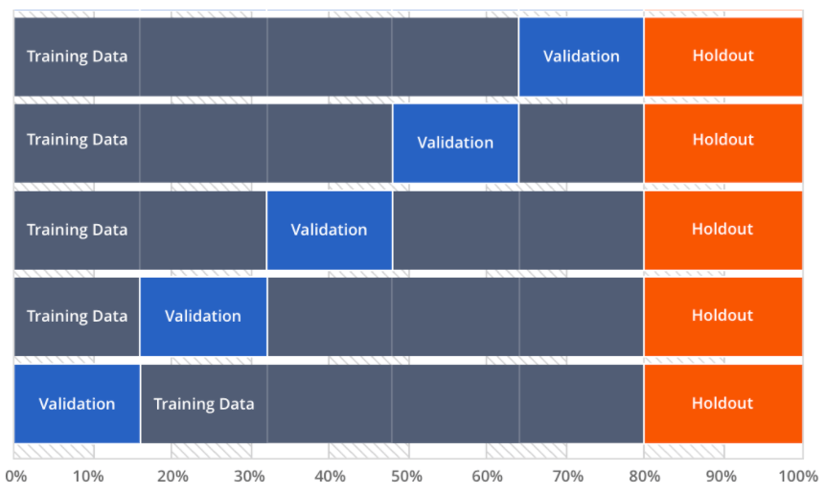
Model selection and cross-validation

Slide 23
Model selection and cross-validation

Slide 24
Model selection and cross-validation
В машинном обучении нужно очень аккуратно избегать оптимизма

Slide 25

Проблема переобучения
Регуляризация
Machine Learning

Slide 26
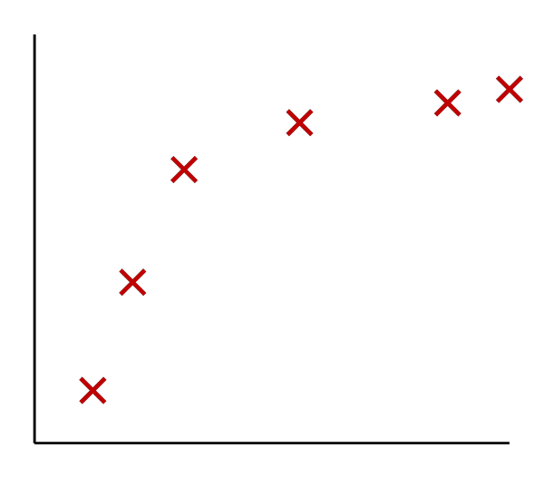
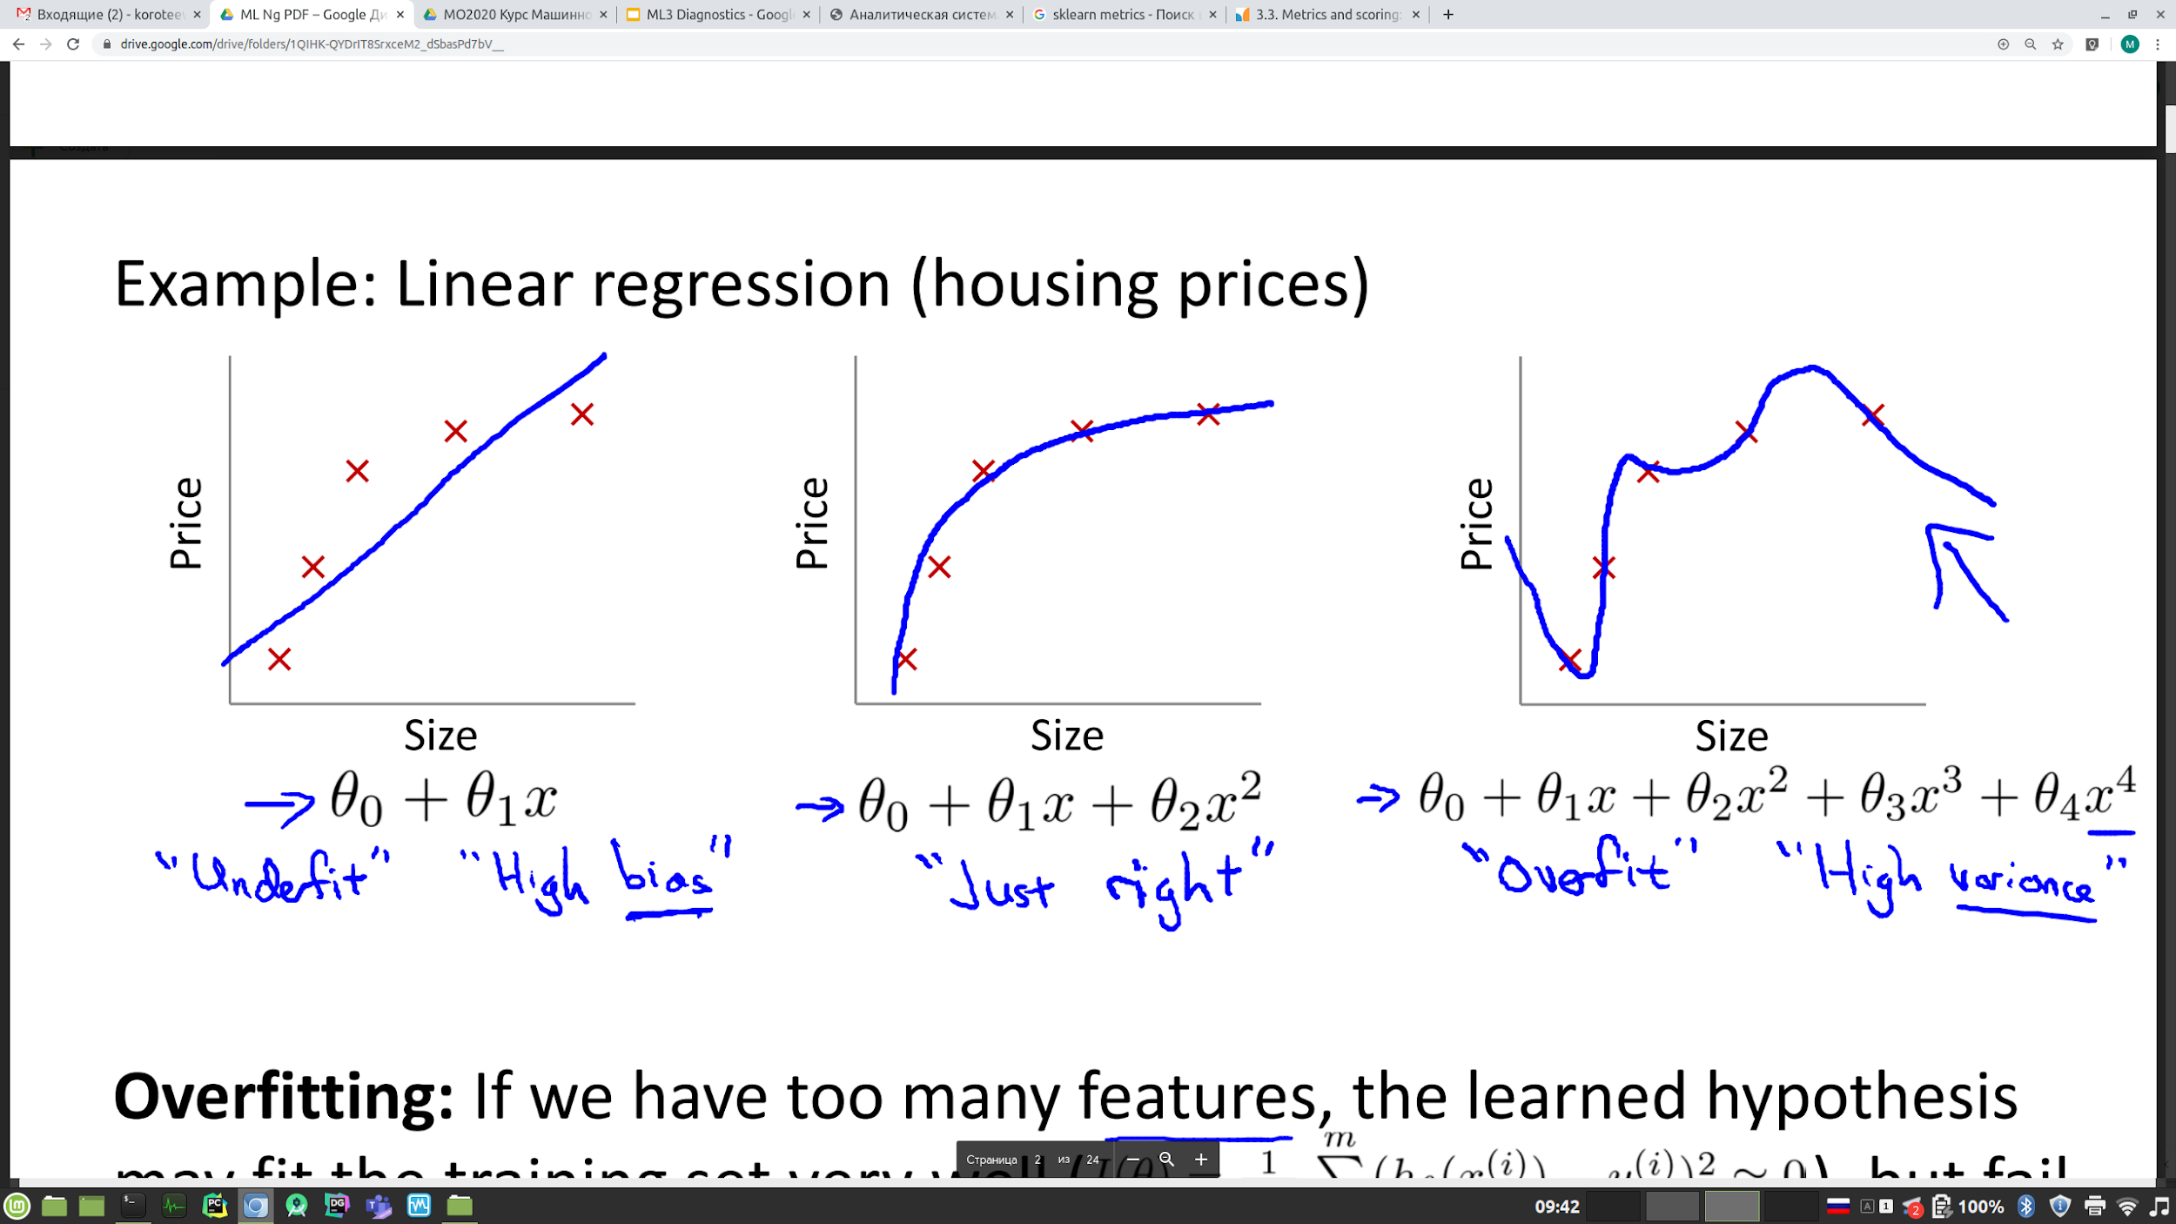
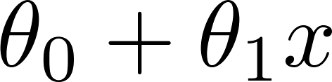
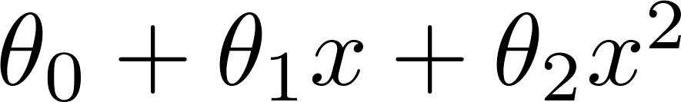
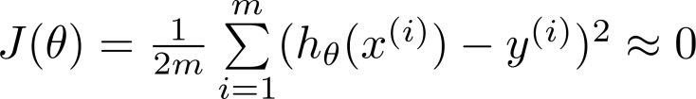
Example: Linear regression (housing prices)
Price
Price
Price
Size
Size
Size
Overfitting: If we have too many features, the learned hypothesis may fit the training set very well ( ), but fail to generalize to new examples (predict prices on new examples).

Slide 27
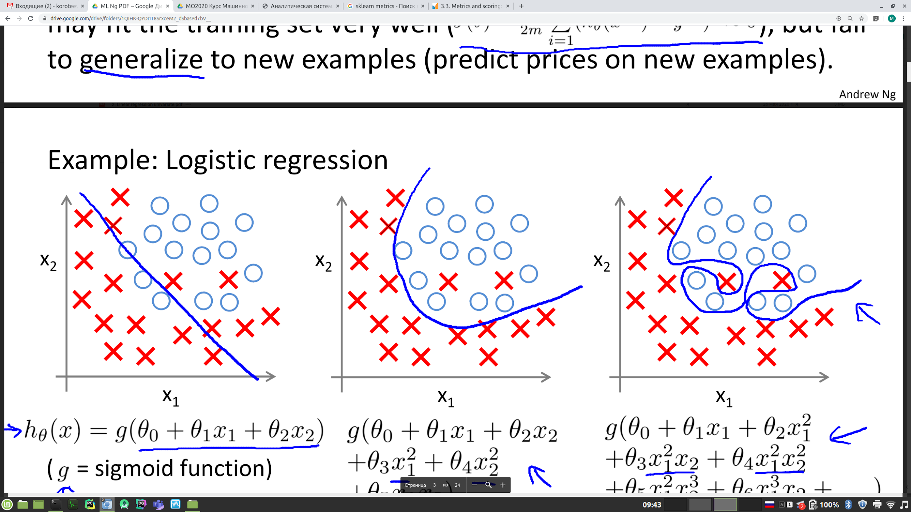
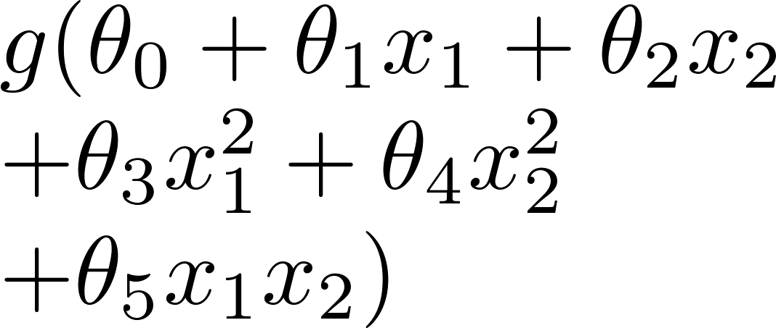
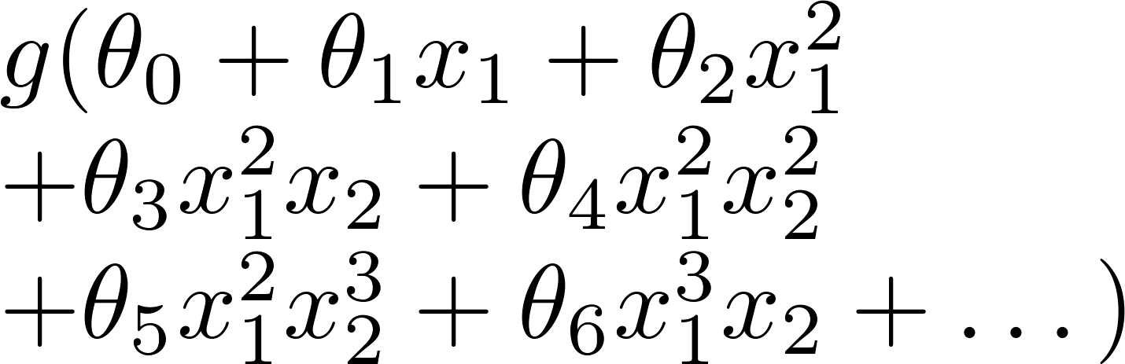
Example: Logistic regression
x₂
x₂
x₂
x₁
x₁
x₁
( = sigmoid function)

Slide 28
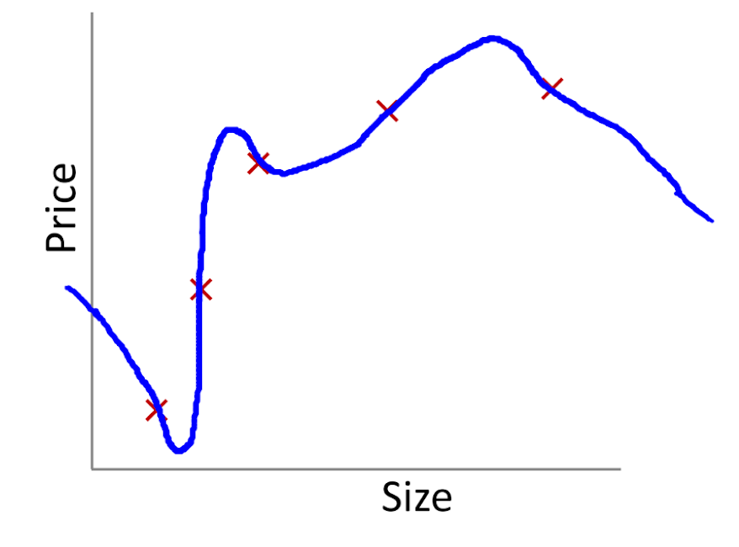
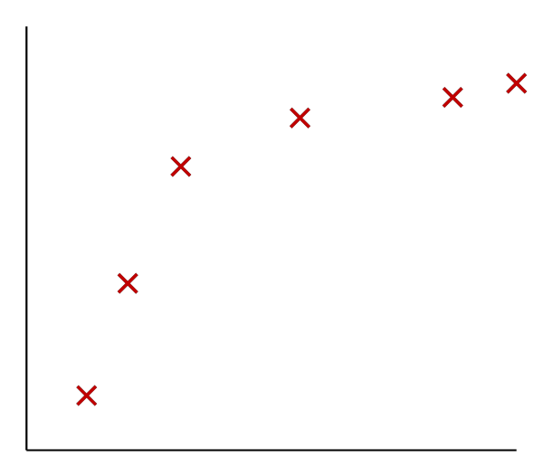
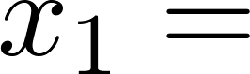
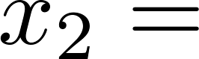
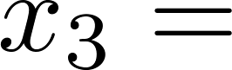
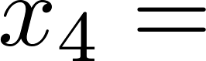
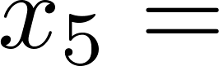
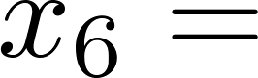
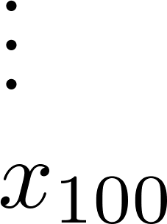
Addressing overfitting:
size of house
no. of bedrooms
Price
no. of floors
age of house
average income in neighborhood
Size
kitchen size

Slide 29
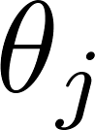
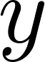
Addressing overfitting:
Options:
Reduce number of features.
Manually select which features to keep.
Model selection algorithm (later in course).
Regularization.
Keep all the features, but reduce magnitude/values of parameters .
Works well when we have a lot of features, each of which contributes a bit to predicting .

Slide 30
Функция ошибки
Регуляризация
Machine Learning

Slide 31

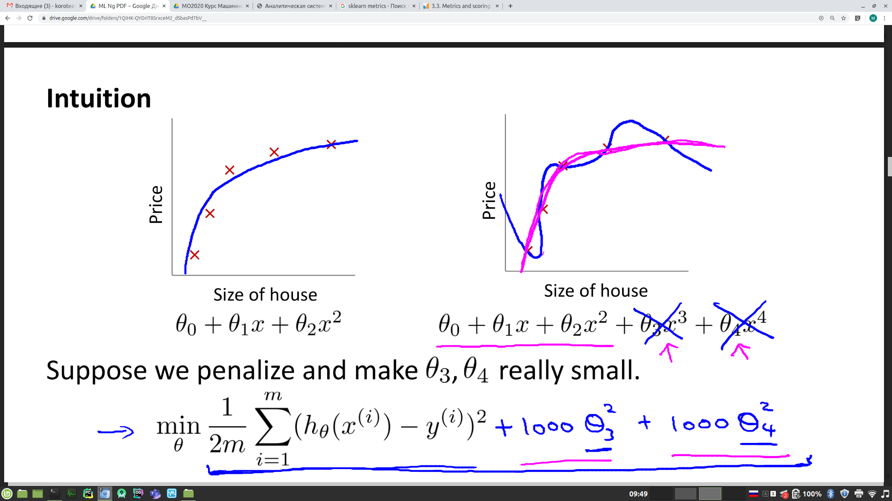
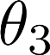
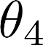
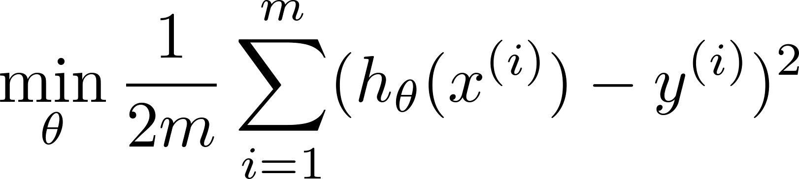
Intuition
Price
Price
Size of house
Size of house
Suppose we penalize and make , really small.

Slide 32
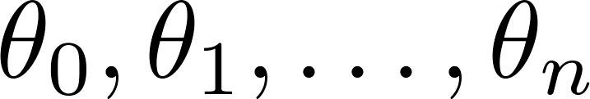
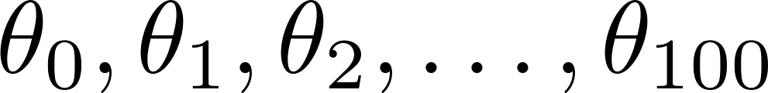
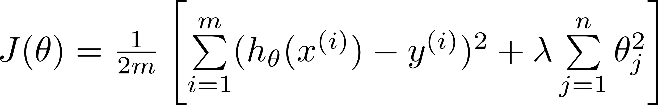
Regularization.
Small values for parameters
“Simpler” hypothesis
Less prone to overfitting
Housing:
Features:
Parameters:

Slide 33
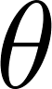

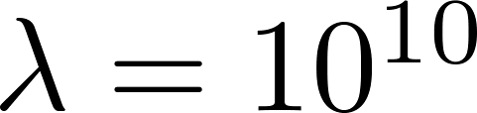
In regularized linear regression, we choose to minimize
What if is set to an extremely large value (perhaps for too large for our problem, say )?
Price
Size of house

Slide 34
Регуляризованная линейная регрессия
Регуляризация
Machine Learning

Slide 35
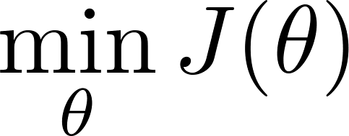
Regularized linear regression

Slide 36

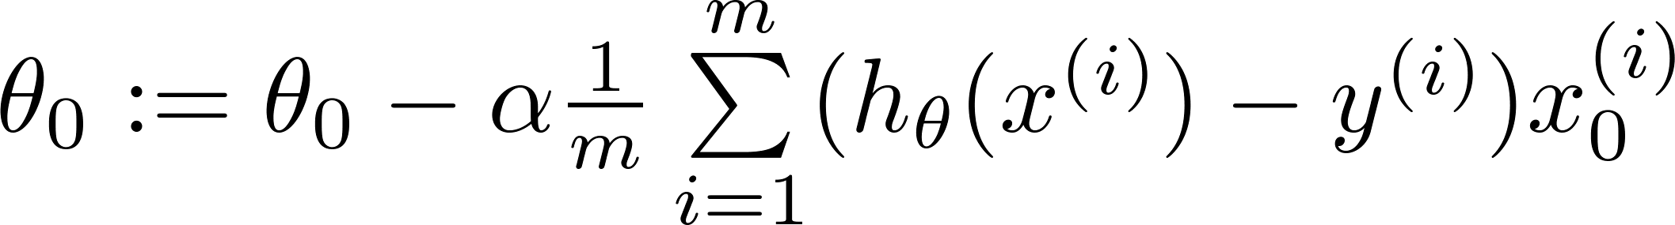
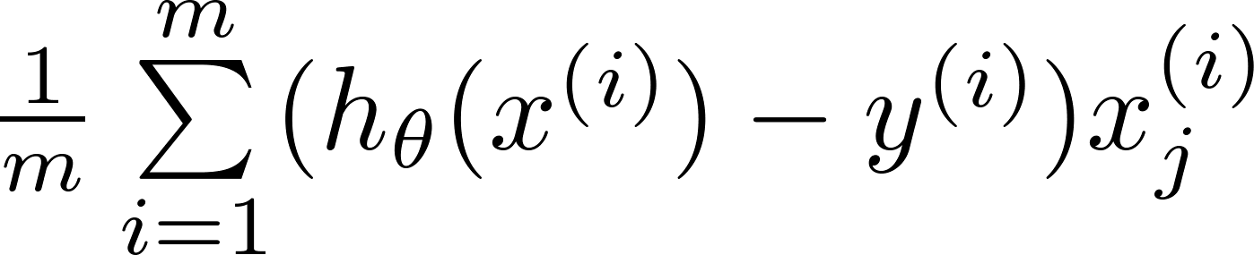
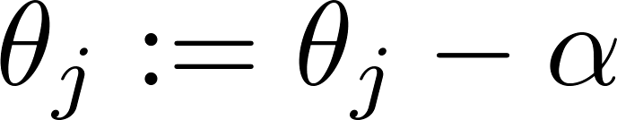
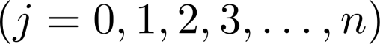
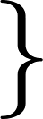
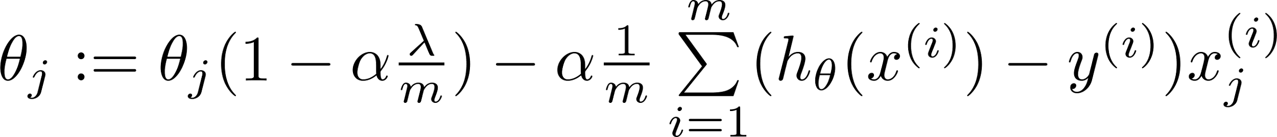
Gradient descent
Repeat

Slide 37
Диагностика систем машинного обучения
Machine Learning

Slide 38
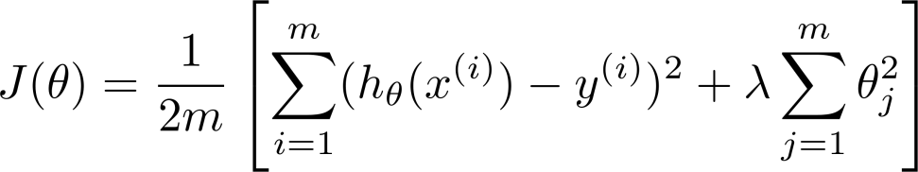
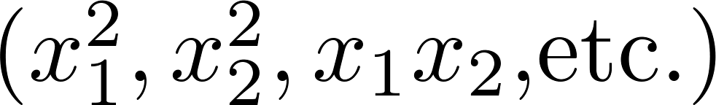
Debugging a learning algorithm:
Suppose you have implemented regularized linear regression to predict housing prices.
However, when you test your hypothesis on a new set of houses, you find that it makes unacceptably large errors in its predictions. What should you try next?
Get more training examples
Try smaller sets of features
Try getting additional features
Try adding polynomial features
Try decreasing
Try increasing

Slide 39
Machine learning diagnostic:
Diagnostic: A test that you can run to gain insight what is/isn’t working with a learning algorithm, and gain guidance as to how best to improve its performance.
Diagnostics can take time to implement, but doing so can be a very good use of your time.

Slide 40
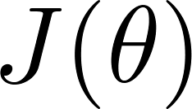
Training/testing procedure for linear regression
Learn parameter from training data (minimizing training error )
Compute test set error.

Slide 41
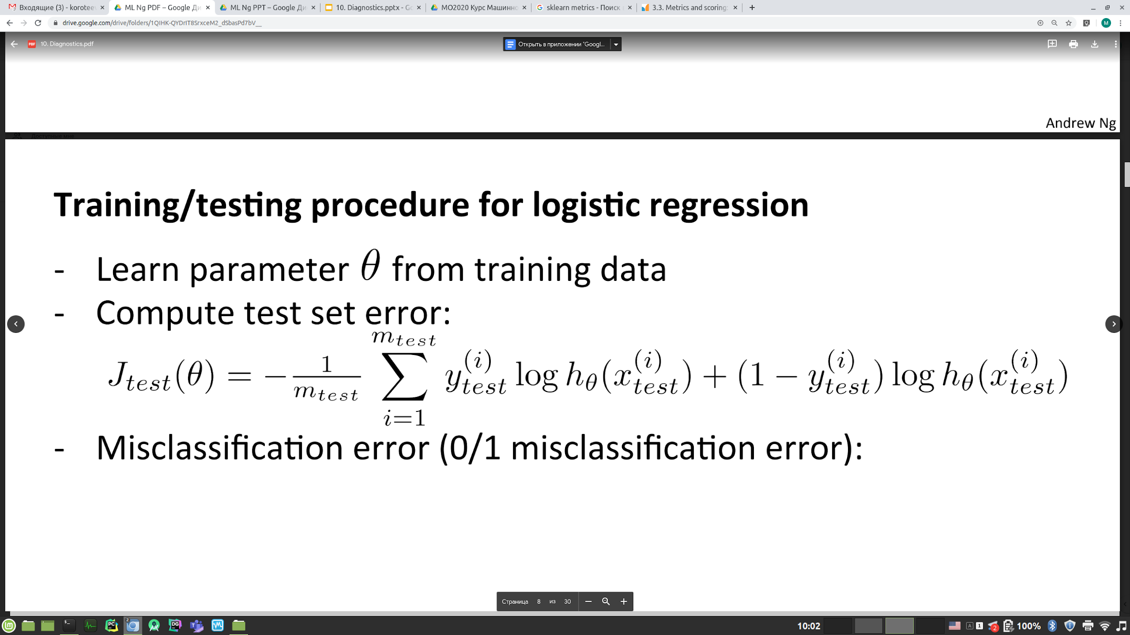
Training/testing procedure for logistic regression
Learn parameter from training data
Compute test set error:
Misclassification error (0/1 misclassification error).

Slide 42
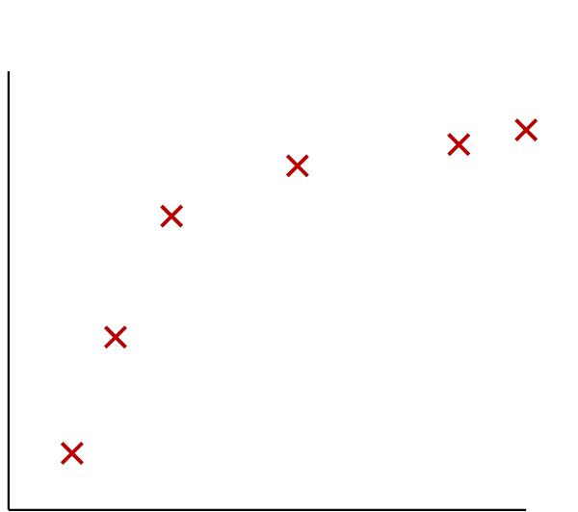
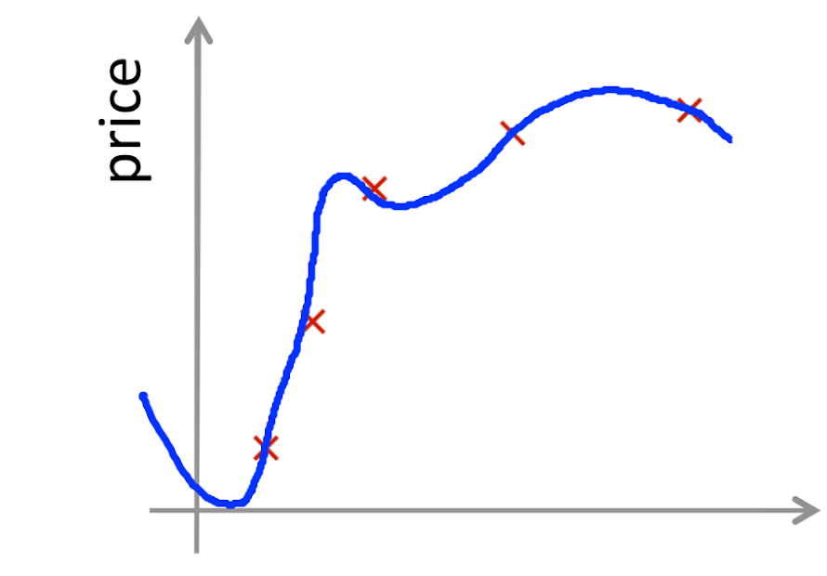
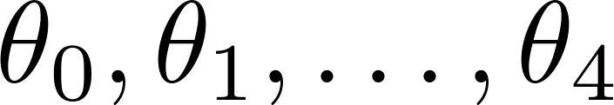
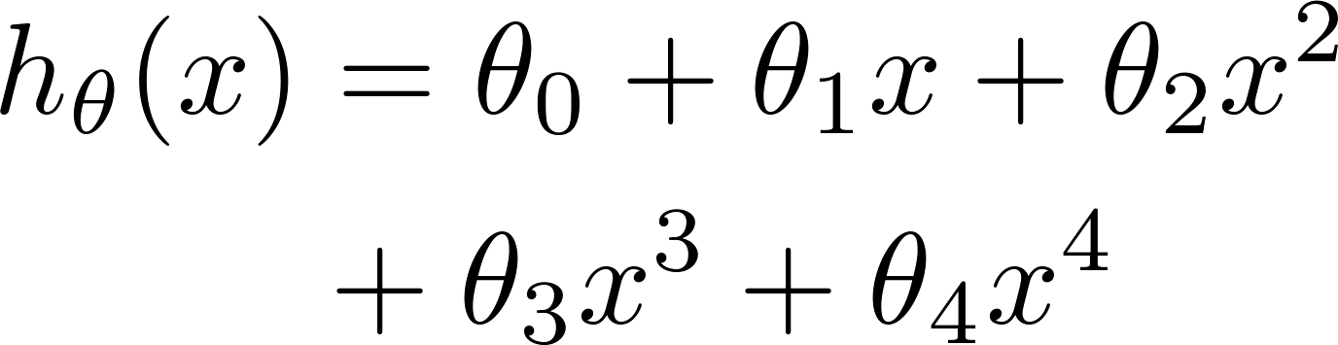
Overfitting example
Once parameters
were fit to some set of data (training set), the error of the parameters as measured on that data (the training error xxxxx) is likely to be lower than the actual generalization error.
price
size

Slide 43

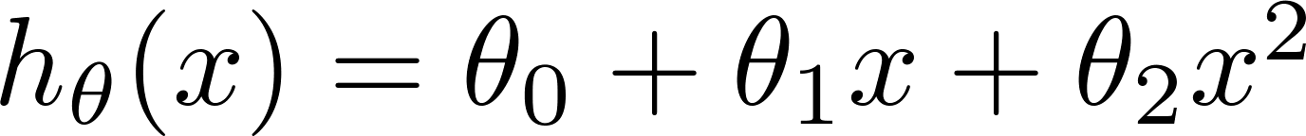
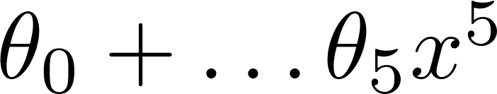


Model selection
1.
2.
3.
10.
Choose
How well does the model generalize? Report test set error .
Problem: is likely to be an optimistic estimate of generalization error. I.e. our extra parameter ( = degree of polynomial) is fit to test set.

Slide 44









Evaluating your hypothesis
Dataset:
Size | Price
2104 | 400
1600 | 330
2400 | 369
1416 | 232
3000 | 540
1985 | 300
1534 | 315
1427 | 199
1380 | 212
1494 | 243

Slide 45



Train/validation/test error
Training error:
Cross Validation error:
Test error:

Slide 46


Model selection
1.
2.
3.
10.
Pick
Estimate generalization error for test set

Slide 47
bias vs. variance
Диагностика систем машинного обучения
Machine Learning

Slide 48




Diagnosing bias vs. variance
Suppose your learning algorithm is performing less well than you were hoping. ( or is high.) Is it a bias problem or a variance problem?
Bias (underfit):
(cross validation
error)
error
Variance (overfit):
(training error)
degree of polynomial d

Slide 49

Choosing the regularization parameter

Slide 50








Choosing the regularization parameter
Model:
Try
Try
Try
Try
Try
Try
Pick (say) . Test error.

Slide 51

Bias/variance as a function of the regularization parameter

Slide 52
Кривые обучения
Диагностика систем машинного обучения
Machine Learning

Slide 53

Learning curves
error
(training set size)

Slide 54



High bias
price
size
price
If a learning algorithm is suffering from high bias, getting more training data will not (by itself) help much.
size

Slide 55


High variance
(and small )
price
size
price
If a learning algorithm is suffering from high variance, getting more training data is likely to help.
size

Slide 56

Debugging a learning algorithm:
Suppose you have implemented regularized linear regression to predict housing prices. However, when you test your hypothesis in a new set of houses, you find that it makes unacceptably large errors in its prediction. What should you try next?
Get more training examples
Try smaller sets of features
Try getting additional features
Try adding polynomial features
Try decreasing
Try increasing

Slide 57
Neural networks and overfitting
“Small” neural network
(fewer parameters; more prone to underfitting)
“Large” neural network
(more parameters; more prone to overfitting)
Computationally cheaper
Computationally more expensive.
Use regularization ( ) to address overfitting.

Slide 58
Анализ ошибок
Диагностика систем машинного обучения
Machine Learning

Slide 59
Recommended approach
Start with a simple algorithm that you can implement quickly. Implement it and test it on your cross-validation data.
Plot learning curves to decide if more data, more features, etc. are likely to help.
Error analysis: Manually examine the examples (in cross validation set) that your algorithm made errors on. See if you spot any systematic trend in what type of examples it is making errors on.

Slide 60

Error Analysis
500 examples in cross validation set
Algorithm misclassifies 100 emails.
Manually examine the 100 errors, and categorize them based on:
What type of email it is
What cues (features) you think would have helped the algorithm classify them correctly.
Pharma:
Replica/fake:
Steal passwords:
Other:
Deliberate misspellings:
(m0rgage, med1cine, etc.)
Unusual email routing:
Unusual (spamming) punctuation:

Slide 61
The importance of numerical evaluation
Should discount/discounts/discounted/discounting be treated as the same word?
Can use “stemming” software (E.g. “Porter stemmer”)
universe/university.
Error analysis may not be helpful for deciding if this is likely to improve performance. Only solution is to try it and see if it works.
Need numerical evaluation (e.g., cross validation error) of algorithm’s performance with and without stemming.
Without stemming: With stemming:
Distinguish upper vs. lower case (Mom/mom):

Slide 62
Метрики эффективности
Диагностика систем машинного обучения
Machine Learning

Slide 63

r2_score
t represents the proportion of variance (of y) that has been explained by the independent variables in the model. It provides an indication of goodness of fit and therefore a measure of how well unseen samples are likely to be predicted by the model, through the proportion of explained variance.
As such variance is dataset dependent, R² may not be meaningfully comparable across different datasets. Best possible score is 1.0 and it can be negative (because the model can be arbitrarily worse). A constant model that always predicts the expected value of y, disregarding the input features, would get a R² score of 0.0.

Slide 64

explained_variance_score
If ̂y is the estimated target output, y the corresponding (correct) target output, and is Variance, the square of the standard deviation, then the explained variance is estimated as follow:
The best possible score is 1.0, lower values are worse.

Slide 65

mean_squared_log_error
Where log_{e}⁡(x) means the natural logarithm of x. This metric is best to use when targets having exponential growth, such as population counts, average sales of a commodity over a span of years etc. Note that this metric penalizes an under-predicted estimate greater than an over-predicted estimate.

Slide 66

accuracy_score
The accuracy_score function computes the accuracy, either the fraction (default) or the count (normalize=False) of correct predictions.
If the entire set of predicted labels for a sample strictly match with the true set of labels, then the subset accuracy is 1.0; otherwise it is 0.0.

Slide 67

Precision vs recall

Slide 68

precision_recall_curve
Intuitively, precision is the ability of the classifier not to label as positive a sample that is negative, and recall is the ability of the classifier to find all the positive samples.
The precision_recall_curve computes a precision-recall curve from the ground truth label and a score given by the classifier by varying a decision threshold.
The average_precision_score function computes the average precision (AP) from prediction scores. The value is between 0 and 1 and higher is better.

Slide 69


F₁ Score (F score)
How to compare precision/recall numbers?
 | Precision(P) | Recall (R) | Average | F₁ Score
Algorithm 1 | 0.5 | 0.4 | 0.45 | 0.444
Algorithm 2 | 0.7 | 0.1 | 0.4 | 0.175
Algorithm 3 | 0.02 | 1.0 | 0.51 | 0.0392
Average:
F₁ Score:

Slide 70

Multiclassification
In multiclass and multilabel classification task, the notions of precision, recall, and F-measures can be applied to each label independently. There are a few ways to combine results across labels, specified by the average argument to the average_precision_score (multilabel only), f1_score, fbeta_score, precision_recall_fscore_support, precision_score and recall_score functions, as described above.
Note that if all labels are included, “micro”-averaging in a multiclass setting will produce precision, recall and F that are all identical to accuracy. Also note that “weighted” averaging may produce an F-score that is not between precision and recall.

Slide 71

confusion_matrix
The confusion_matrix function evaluates classification accuracy by computing the confusion matrix with each row corresponding to the true class (Wikipedia and other references may use different convention for axes).
By definition, entry (i, j) in a confusion matrix is the number of observations actually in group i, but predicted to be in group j. Here is an example:

Slide 72

classification_report
The classification_report function builds a text report showing the main classification metrics. Here is a small example with custom target_names and inferred labels:

Slide 73

ROC
A receiver operating characteristic (ROC), or simply ROC curve, is a graphical plot which illustrates the performance of a binary classifier system as its discrimination threshold is varied. It is created by plotting the fraction of true positives out of the positives (TPR = true positive rate) vs. the fraction of false positives out of the negatives (FPR = false positive rate), at various threshold settings. TPR is also known as sensitivity, and FPR is one minus the specificity or true negative rate.

Slide 74
roc_auc_score
The roc_auc_score function computes the area under the receiver operating characteristic (ROC) curve, which is also denoted by AUC or AUROC. By computing the area under the roc curve, the curve information is summarized in one number.
Чем выше показатель AUC, тем качественнее классификатор, при этом значение 0,5 демонстрирует непригодность выбранного метода классификации (соответствует случайному гаданию). Значение менее 0,5 говорит, что классификатор действует с точностью до наоборот: если положительные назвать отрицательными и наоборот, классификатор будет работать лучше.

Slide 75
Выбор модели
Диагностика систем машинного обучения
Machine Learning

Slide 76
Параметры и гиперпараметры
Параметры - это численные коэффициенты, которые изменяются в процессе обучения.
Степень многочлена полиномиальной регрессии можно рассматривать как гиперпараметр модели. Другой пример - скорость обучения.
Гиперпараметры позволяют рассматривать семейство однотипных моделей как одну.
Гиперпараметры не обязательно численны.
Разные значения гиперпараметров - разные модели - разные результаты - разная эффективность.

Slide 77

Parameters and hyperparameters

Slide 78
Parameters and hyperparameters
При изменении (оптимизации) гиперпараметров обучение нужно запускать заново.

Slide 79
Hyperparameters and model design

Slide 80

Hyperparameters and model design

Slide 81
Hyperparameters and model design
Гиперпараметры относятся к архитектуре и дизайну моделей.

Slide 82
Model selection and cross-validation
В машинном обучении нужно очень аккуратно избегать оптимизма

Slide 83
Model selection and cross-validation

Slide 84
Model selection and cross-validation

Slide 85

Робастные оценки эффективности
>>> from sklearn.model_selection import cross_validate
>>> from sklearn.metrics import recall_score
>>> scoring = ['precision_macro','recall_macro']
>>> clf =
svm.SVC(kernel='linear', C=1, random_state=0)
>>> scores =
cross_validate(clf, X, y, scoring=scoring)
>>> sorted(scores.keys())
['fit_time', 'score_time',
'test_precision_macro', 'test_recall_macro']
>>> scores['test_recall_macro']
array([0.96..., 1. ..., 0.96..., 0.96..., 1. ])

Slide 86


